Slide 1
MR workshop
Joëlle Pasman
June 21, 2023

Slide 2
Set up
Techniques & solutions
Examples
MR Base Tutorial

Slide 3
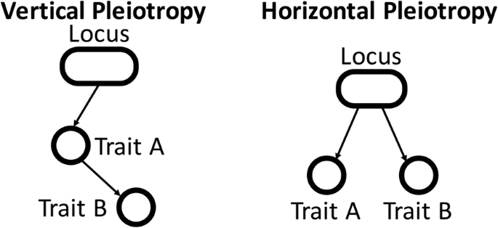
Checking assumptions
Exclusivity:
Horizontal pleiotropy
MR Egger
Bidirectional association
Relevance:
Weak instrument bias/ NOME
Heterogeneity
F statistic (I² for Egger)
Q
Independence:
Vertical pleiotropy
?

Slide 4

Correcting for violations
Exclusivity:
MR Egger
Bidirectional association
Weighted mode & median
MR-PRESSO
Radial MR
Steiger filtering
Relevance:
Weighted mode & median
Select GWAS with sufficient power
Sample size
Number of hits
h²_{SNP}
Increase p-threshold
Leave-one-out
Radial MR
Independence:
Multivariable MR
Manual filtering
Latent heritable confounder MR

Slide 5

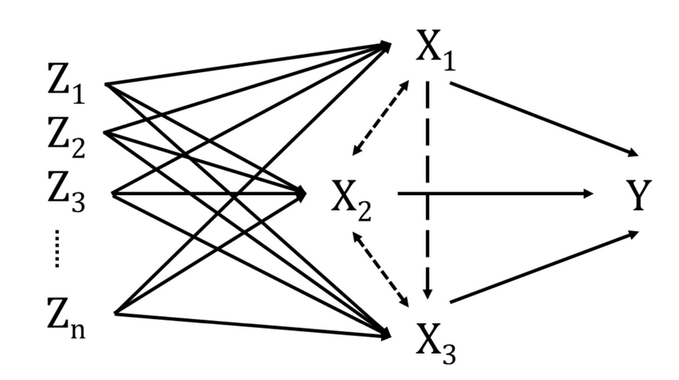
Correcting for independence
Multivariable MR

Slide 6
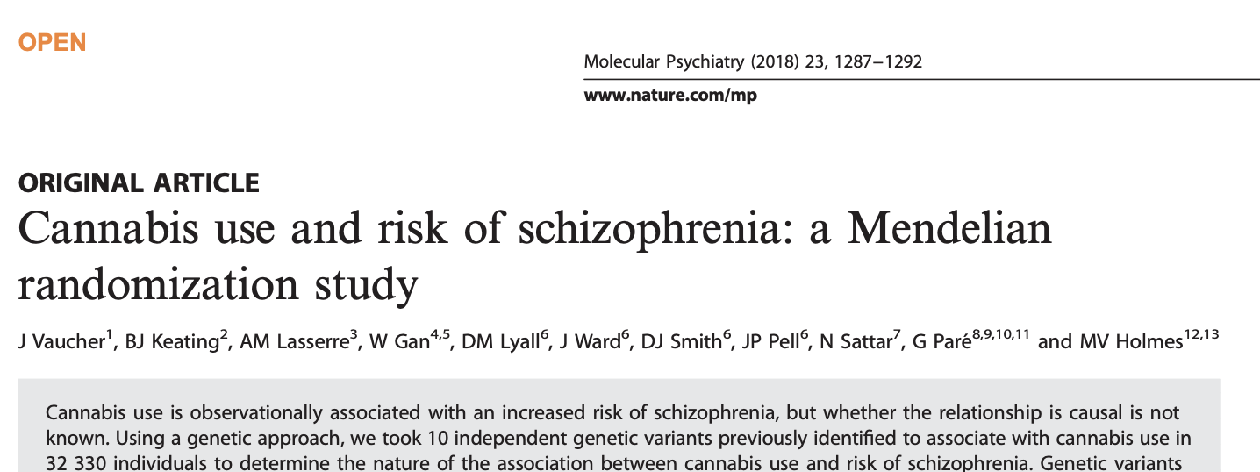
Correcting for independence
Multivariable MR

Slide 7
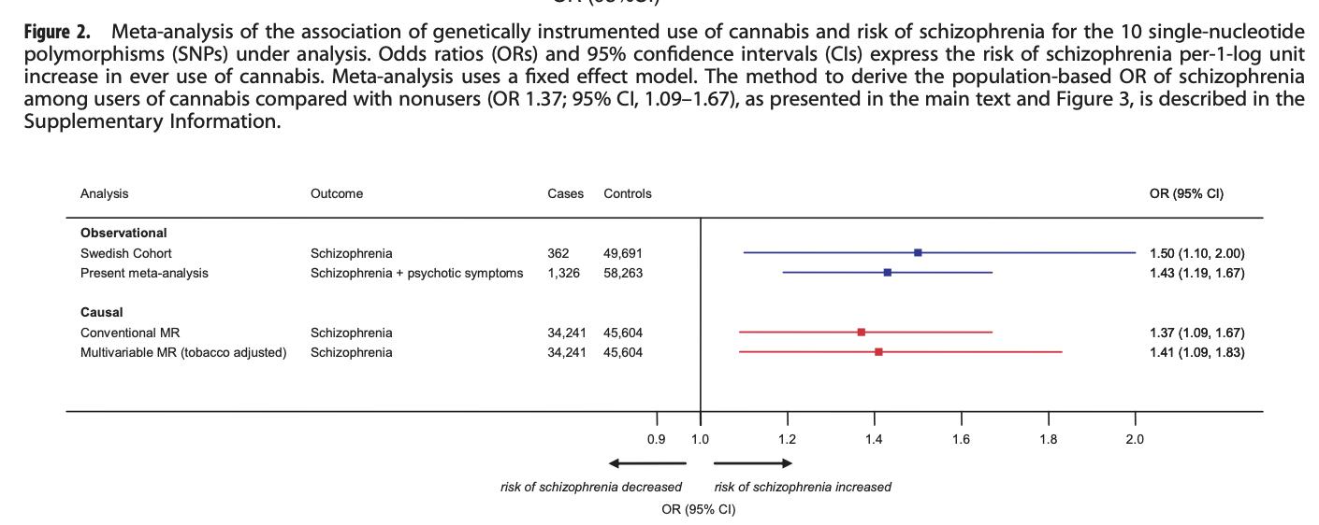
Correcting for independence
Multivariable MR

Slide 8
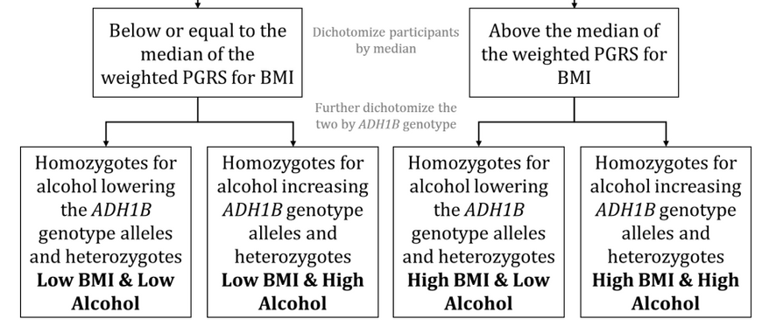
Correcting for independence
Multivariable MR
MediationMR https://github.com/alicerosecarter/MediationMR
Interaction: Factorial MR (One-Sample)
E.g., BMI-PRS X ADH1B -> liver disease

Slide 9
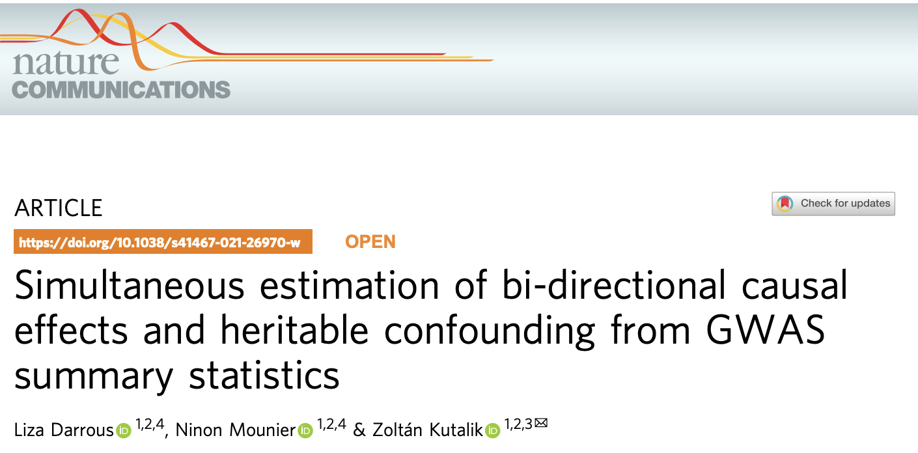
Correcting for independence and sample overlap
Sample overlap
Some bias (either direction)
Minor problem at high N
Latent heritable confounder MR (also for independence)

Slide 10
Correcting for independence and sample overlap
Using structural equation modeling to introduce a latent heritable factor
Distinguish SNPs as confounder or causal

Slide 11
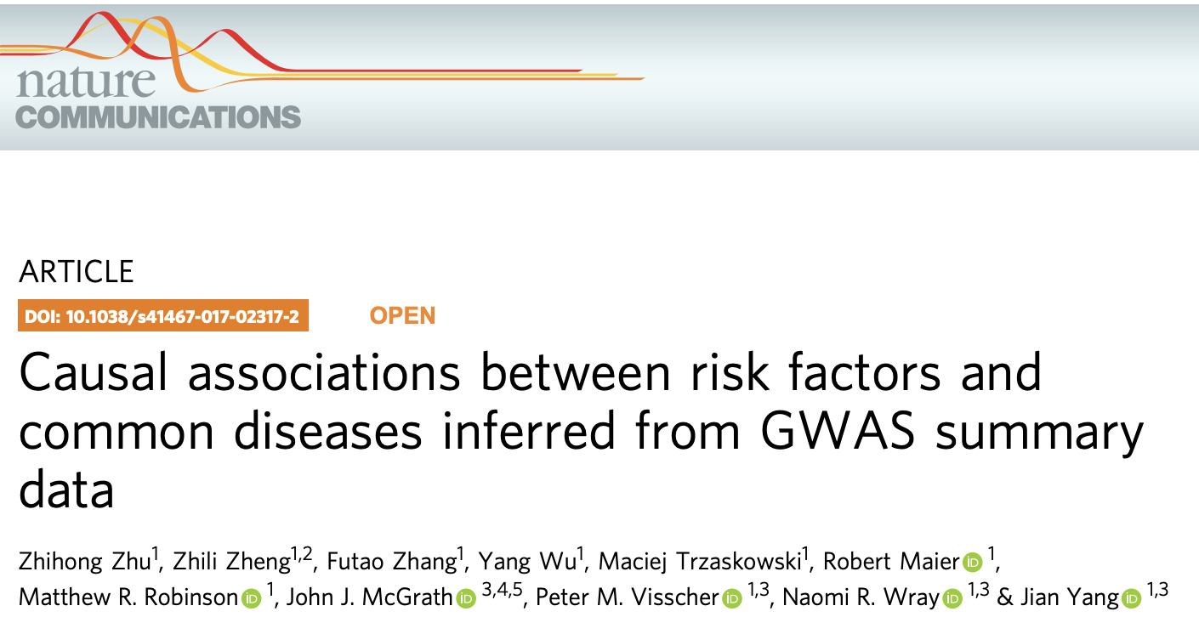
Increasing relevance
Standard method is strict LD pruning
Generalised summary-data based MR (GSMR) combines SNP effects using GLS while accounting for LD
More powerful
Implemented in GCTA

Slide 12
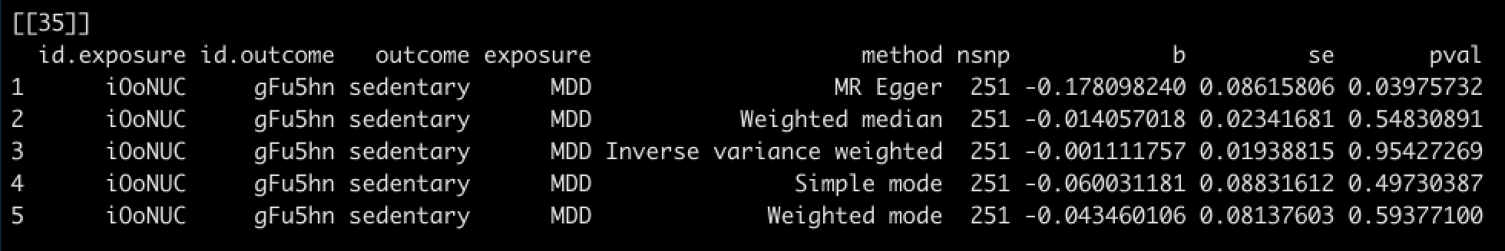
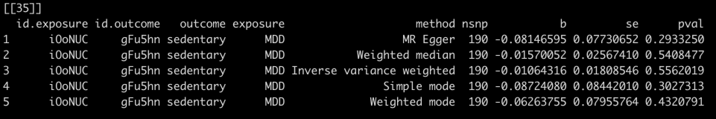
Examples
MDD -> sedentary behavior
Before Steiger filtering
After Steiger filtering

Slide 13
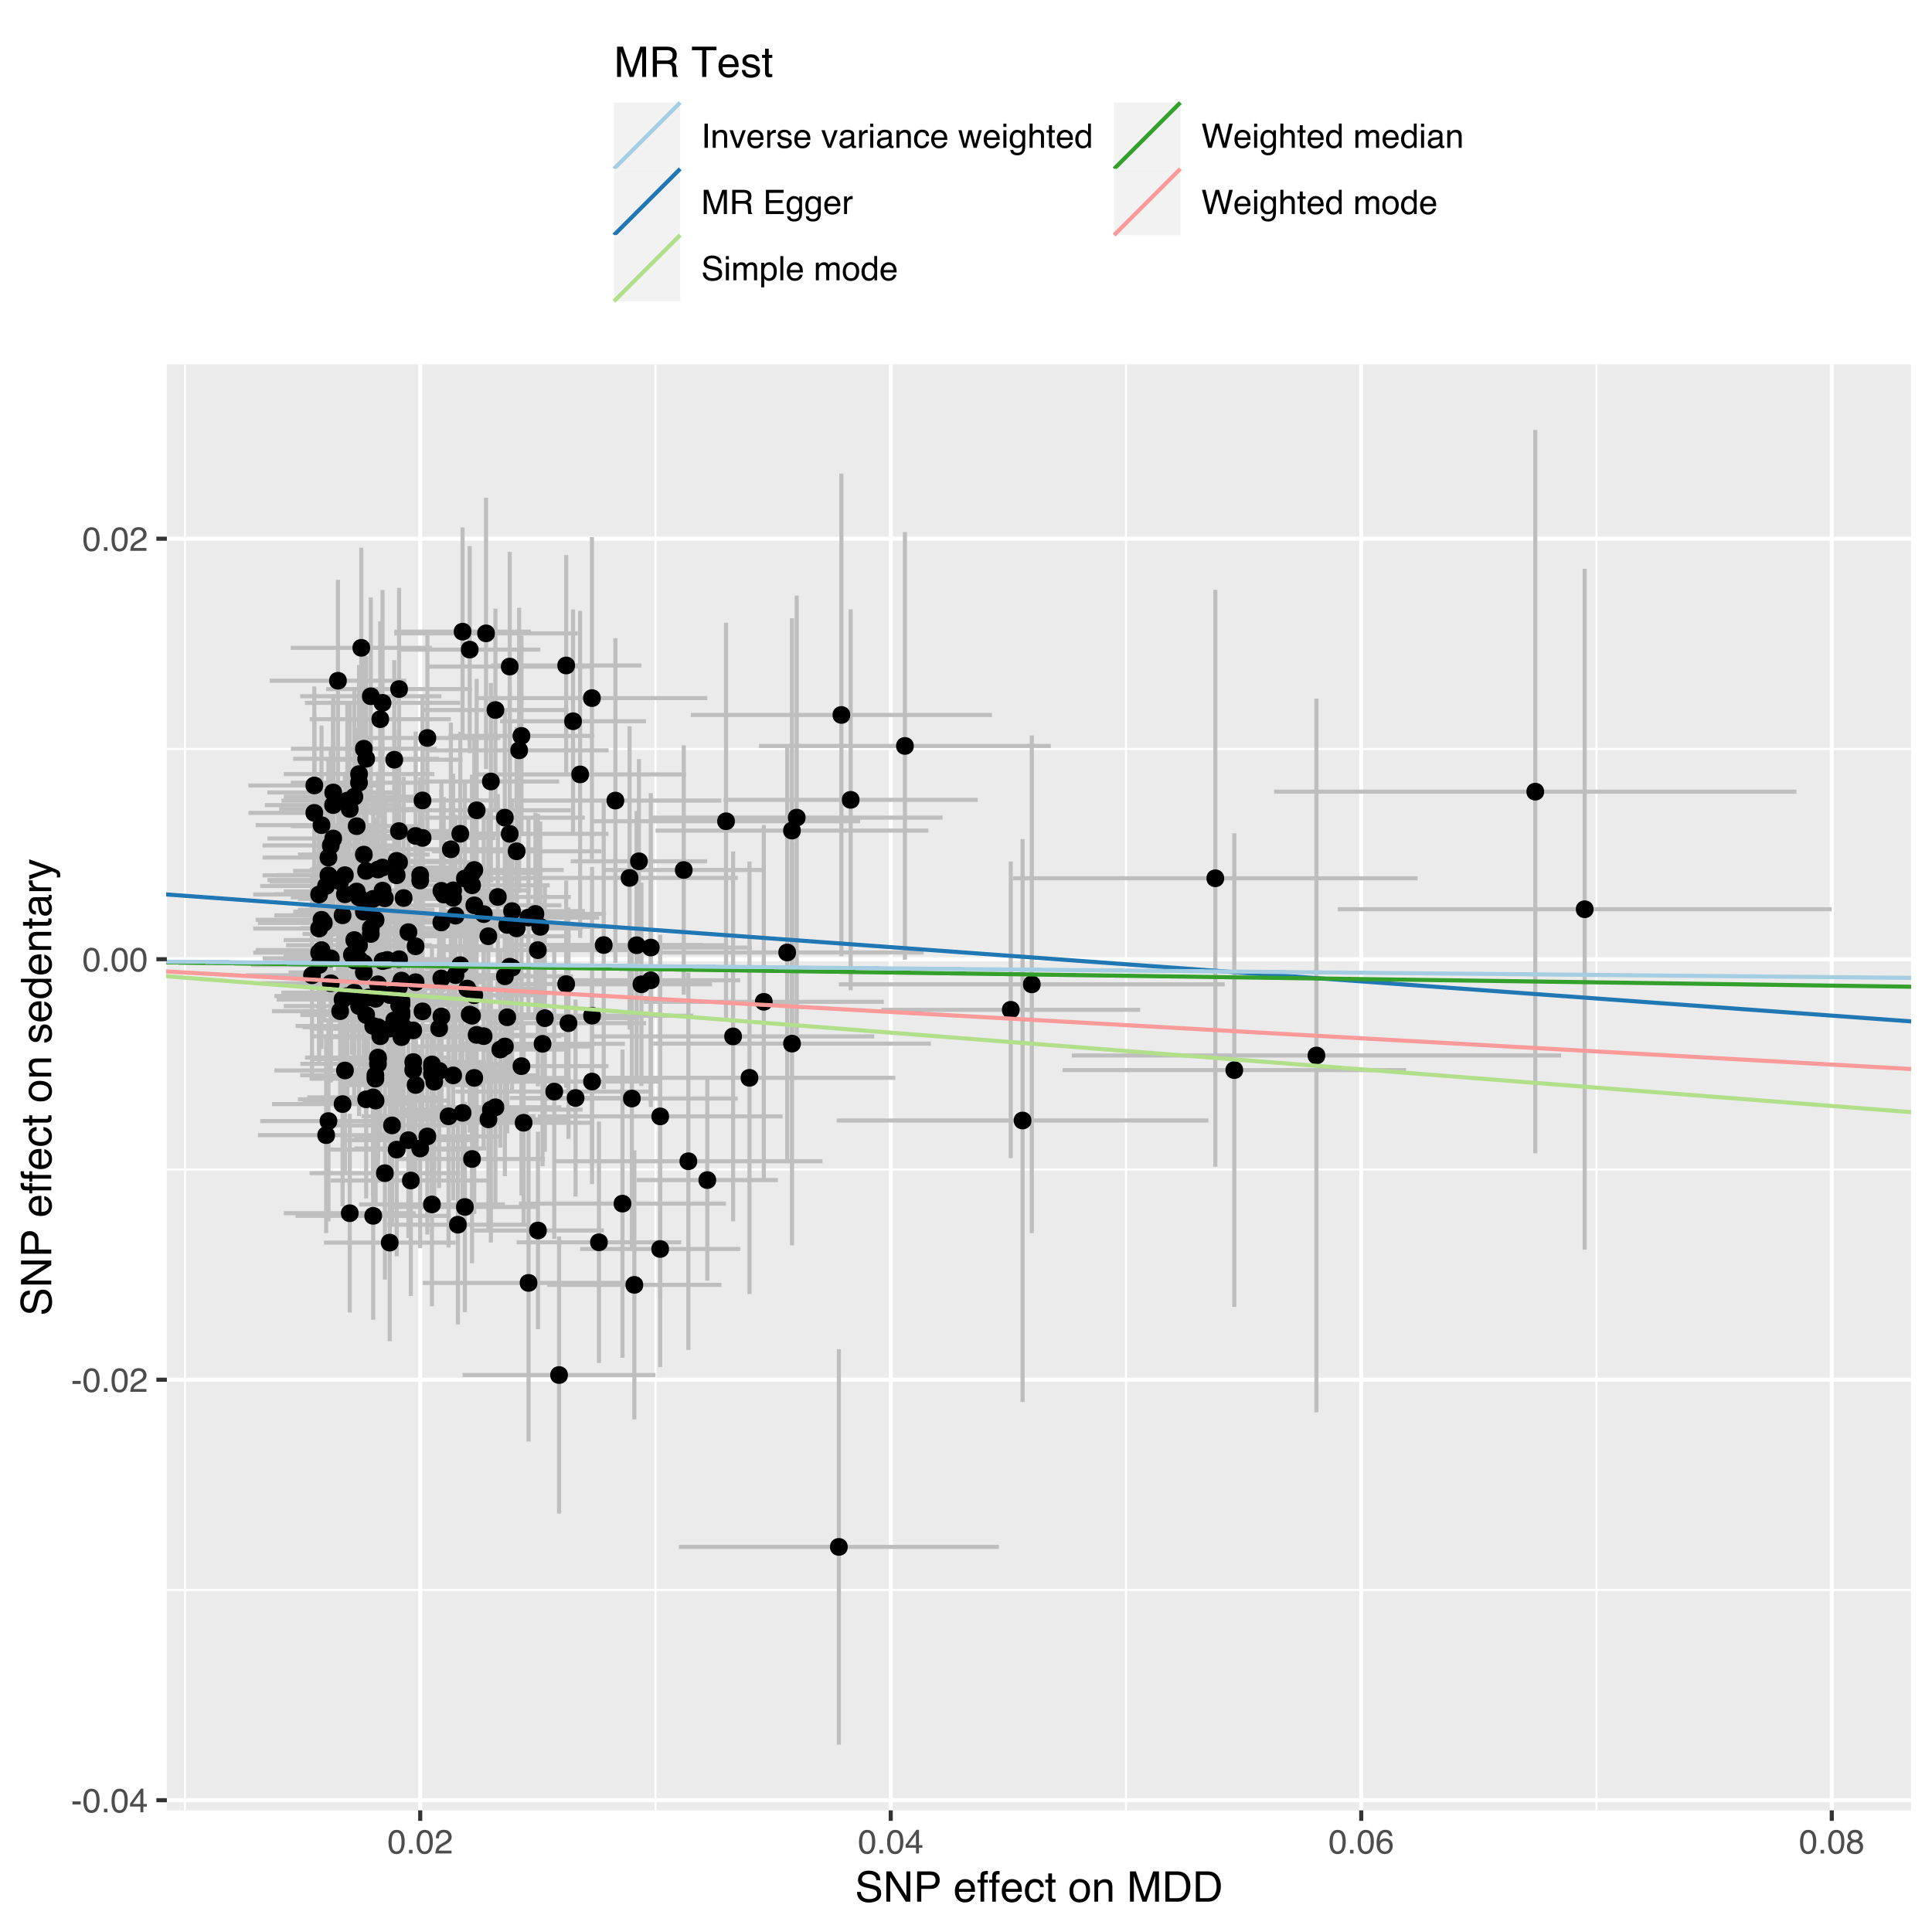
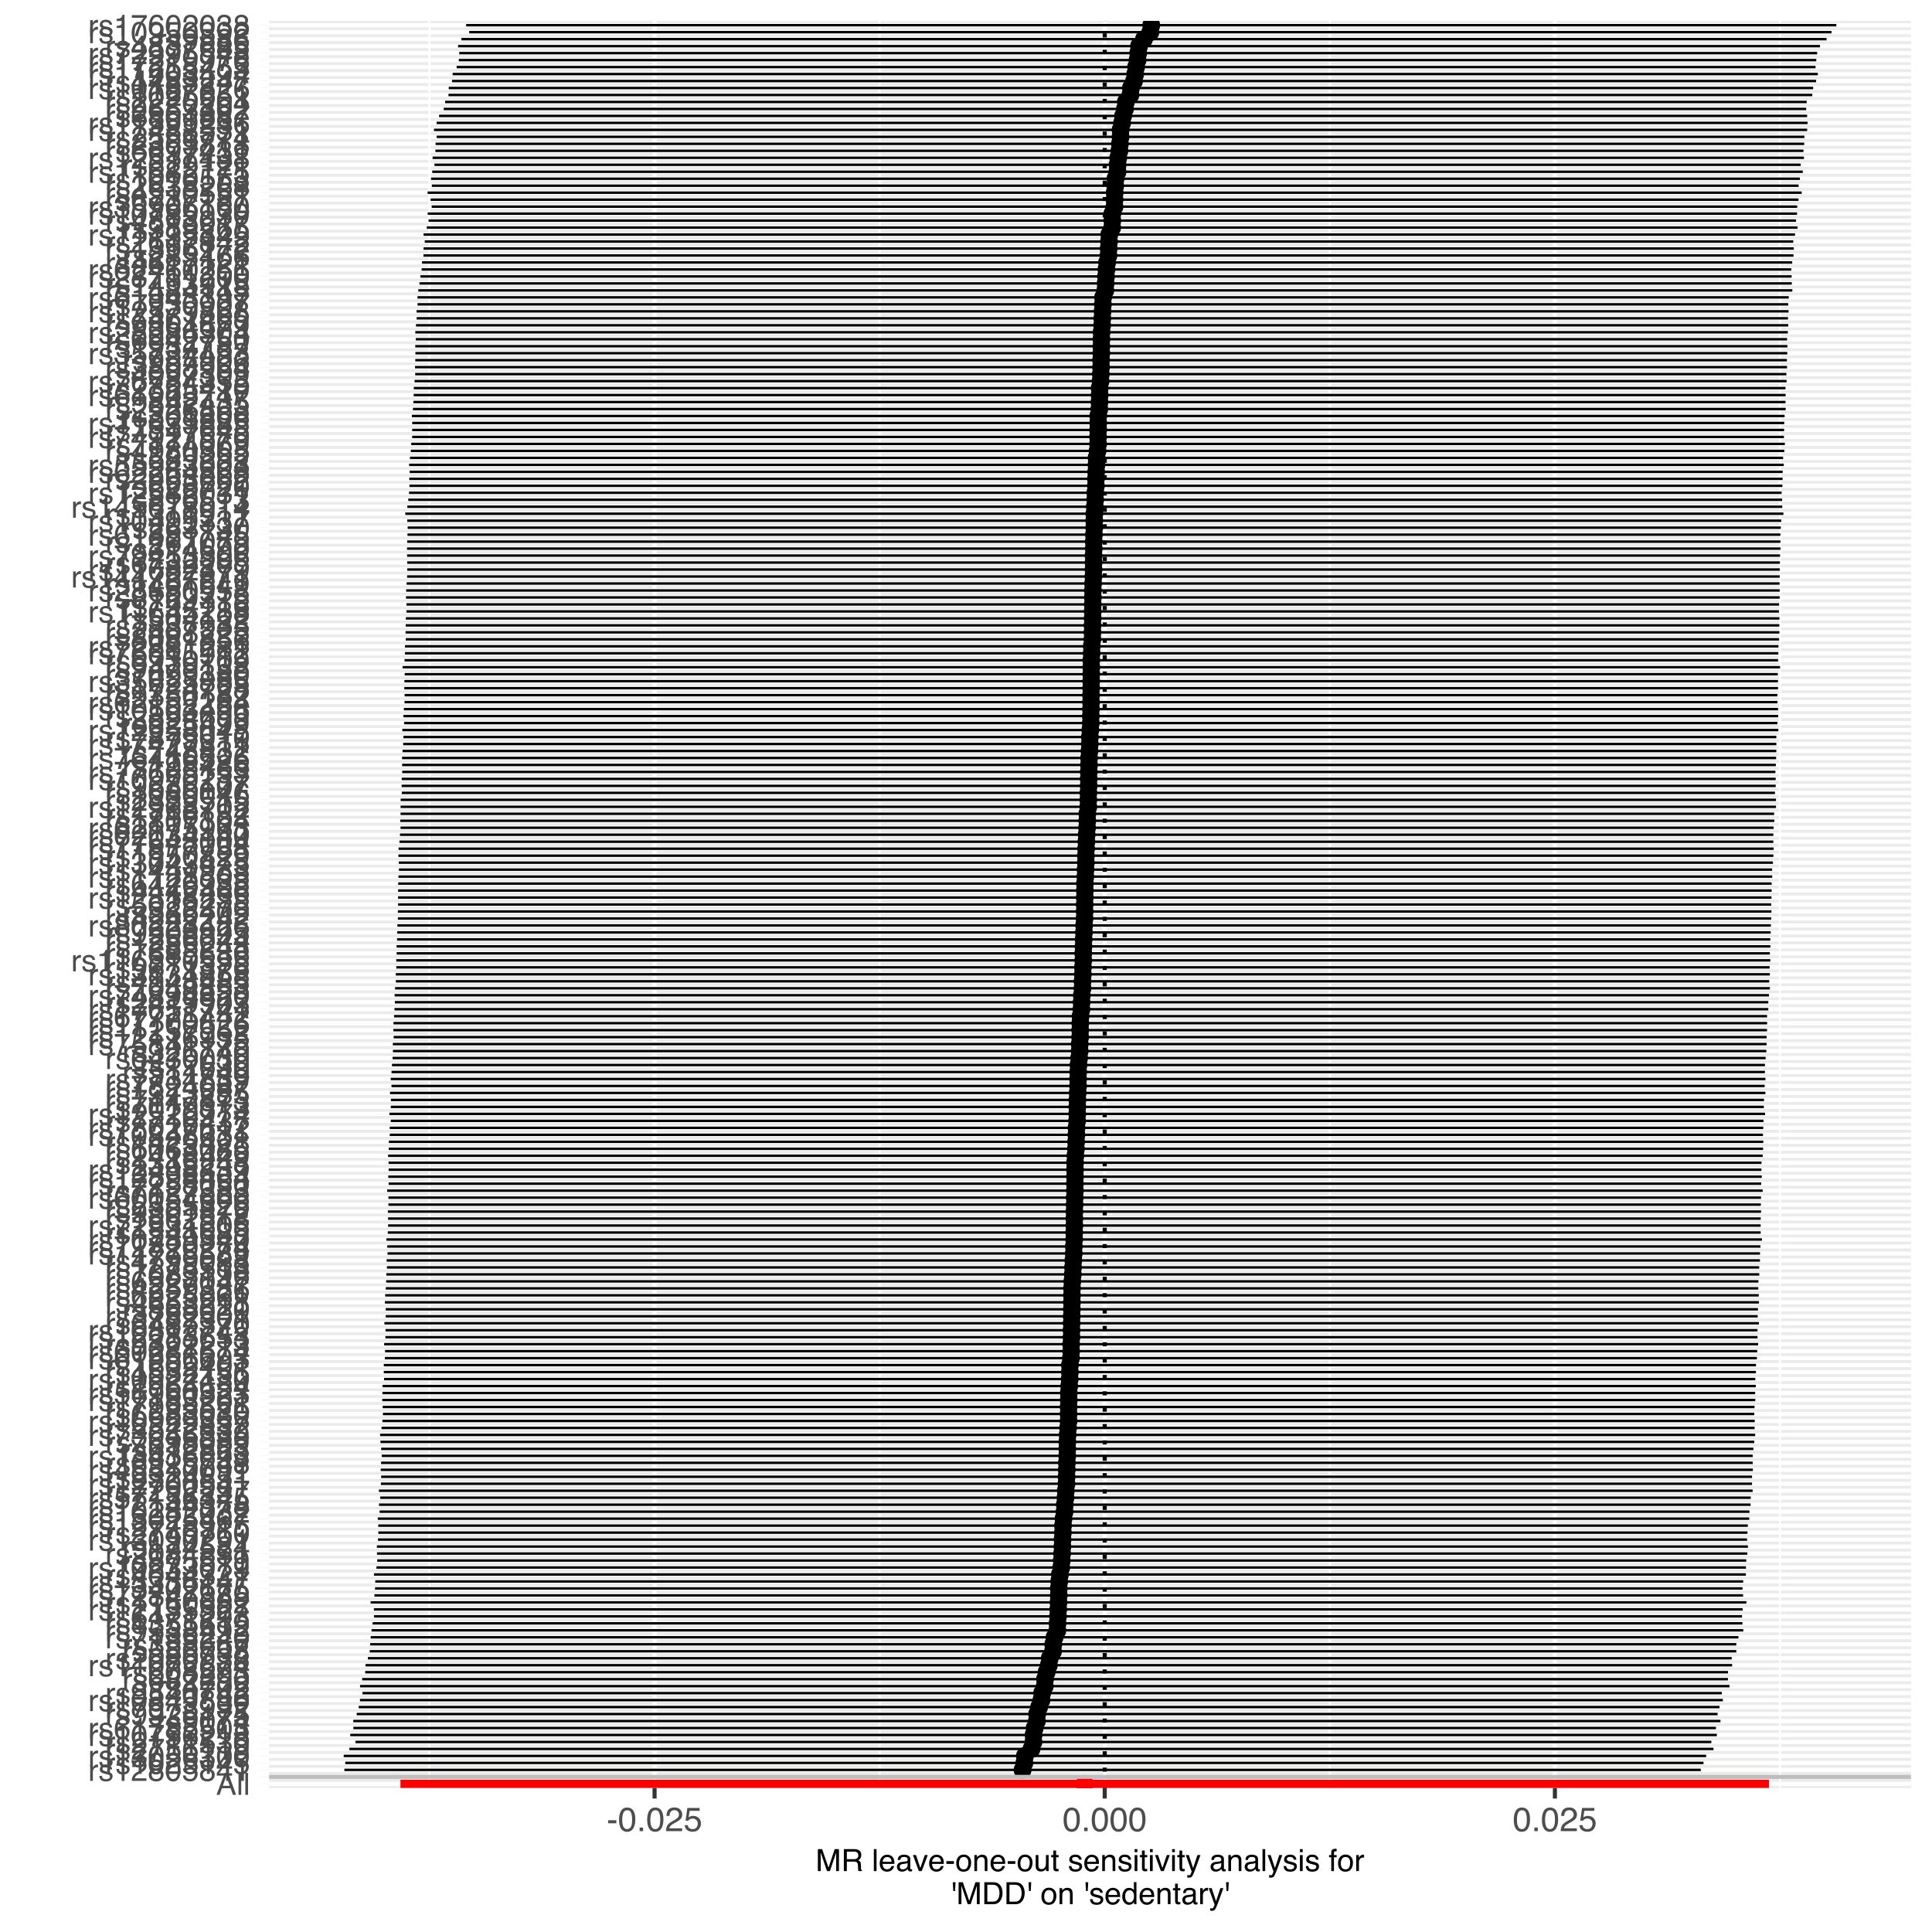
Examples
MDD -> sedentary behavior

Slide 14
Examples
MDD -> sedentary behavior
MR-Egger intercept p=.03
MR PRESSO: no outliers, so unchanged
GSMR: towards 0
R²=0.4%
F=32
I²=.52
Q p=.999
!
!

Slide 15
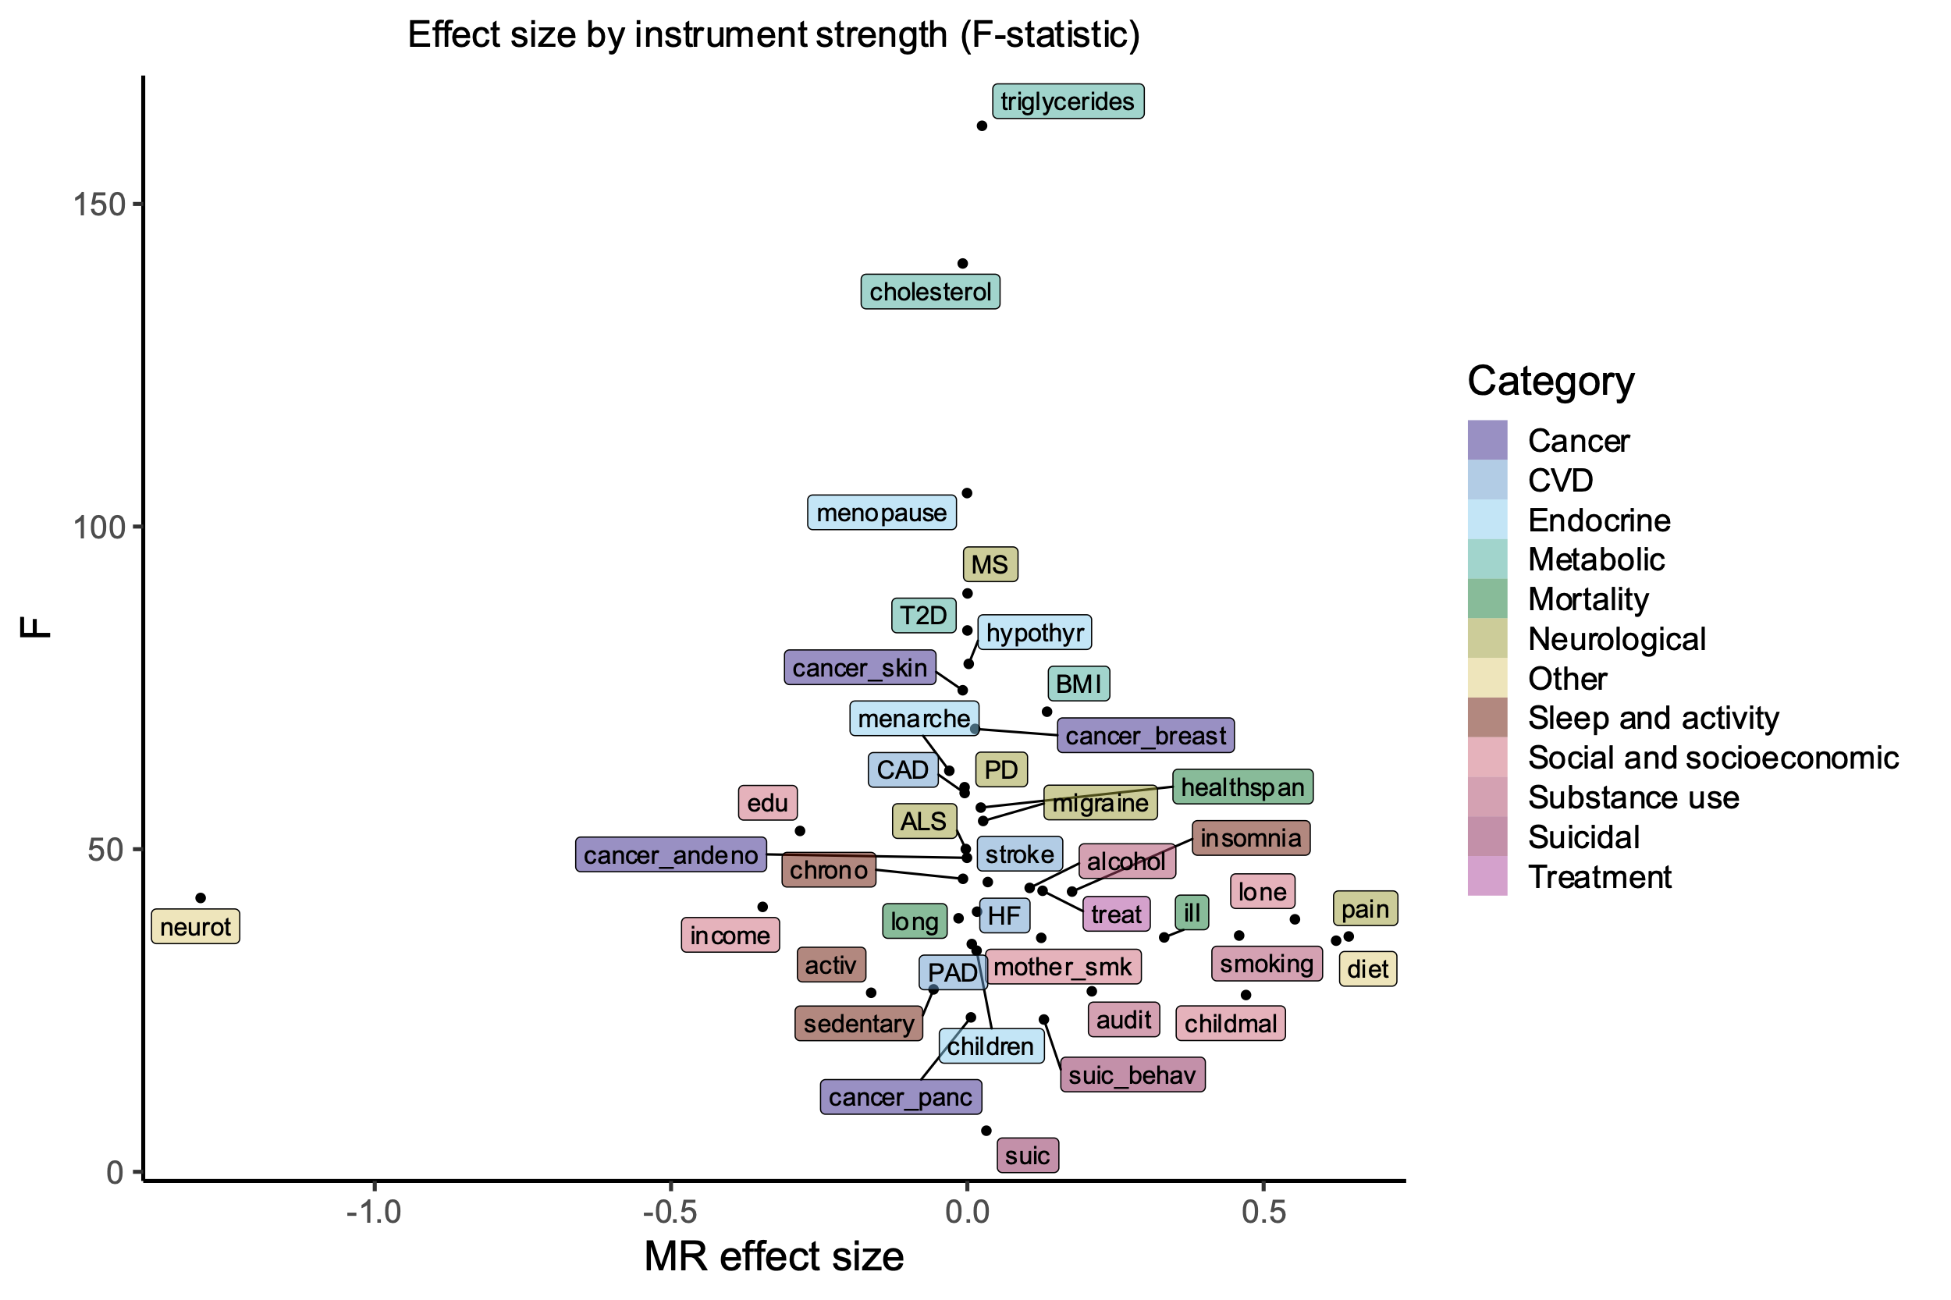
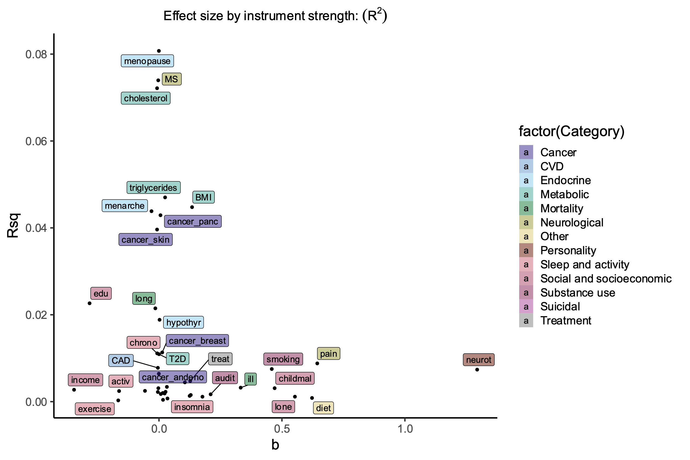
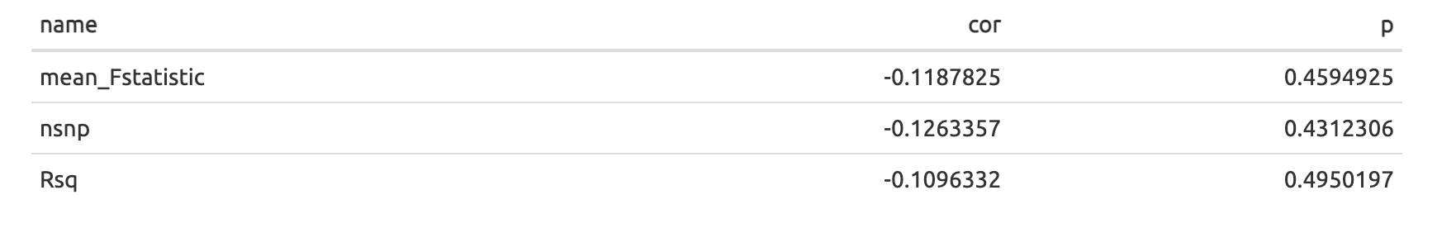
Power
Power & instrument strength
MDD as outcome

Slide 16
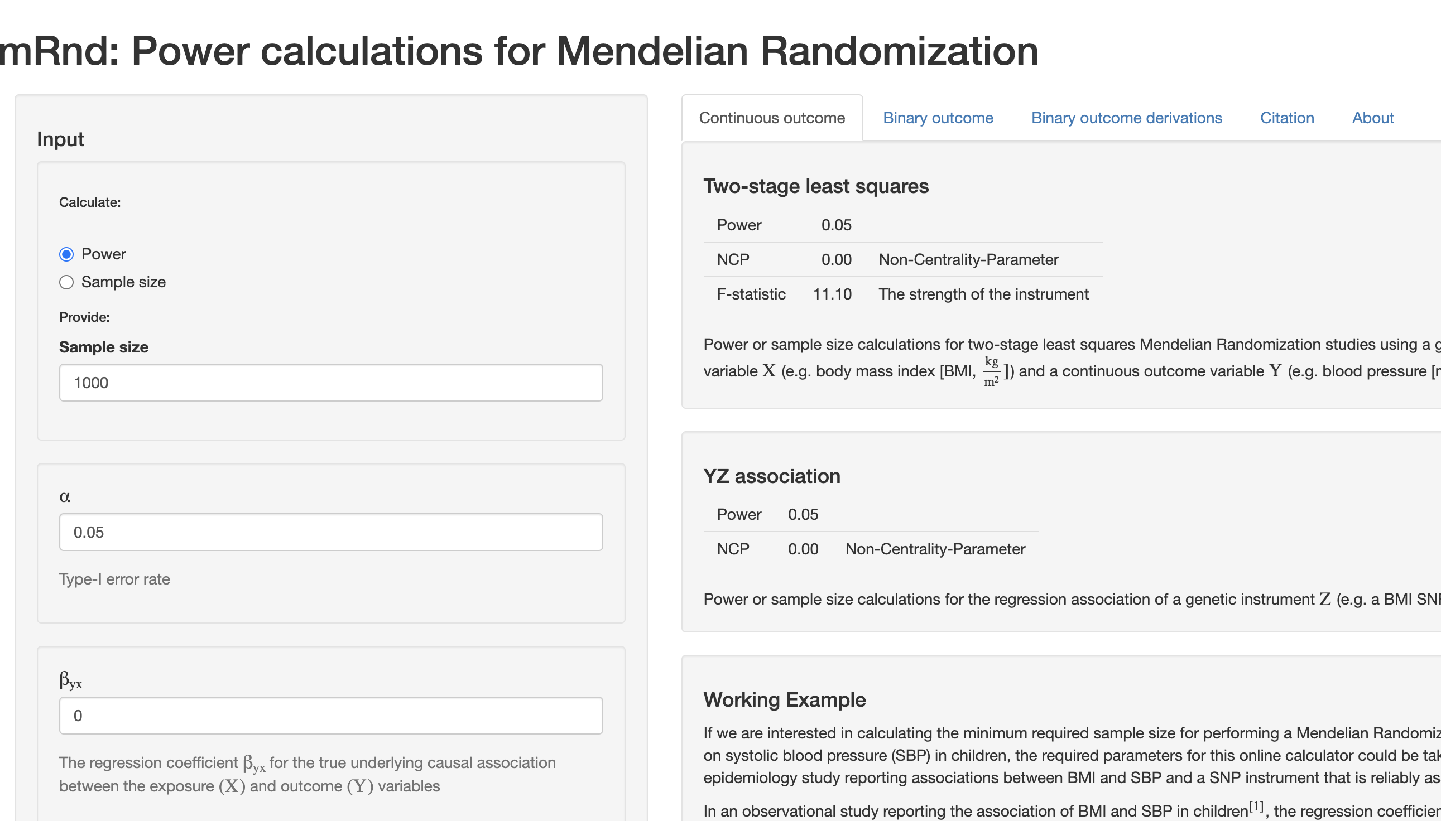
Power
https://shiny.cnsgenomics.com/mRnd/

Slide 17
Resources
Glossary:
http://mr-dictionary.mrcieu.ac.uk
MR Base:
http://app.mrbase.org/
MR power:
https://shiny.cnsgenomics.com/mRnd/
Methods primer:
https://www.nature.com/articles/s43586-021-00092-5
R package with great documentation:
https://mrcieu.github.io/TwoSampleMR/

Slide 18
MR-Base tutorial
http://app.mrbase.org/
Is there evidence for a causal effect of X on Y?
Is the evidence consistent across the different sensitivity analyses?
Is there evidence for horizontal pleiotropy?
Are the effects consistent across the different instrument SNPs?
Is the analysis disproportionally affected by a single SNP?
Is there evidence for a causal effect in the other direction (re-run the model with exposure and outcome reversed)?

